Slide 1
Lambda Calculus
Lecturer: Ngo Huy Bien
Software Engineering Department
Faculty of Information Technology
VNUHCM - University of Science
Ho Chi Minh City, Vietnam
nhbien@fit.hcmus.edu.vn

Slide 2

Objectives

Slide 3

References
Peter Selinger. Lecture Notes on the Lambda Calculus. 2007.

Slide 4
λ-Calculus (Lambda Calculus)
https://medium.com/towards-data-science/how-bend-works-a-parallel-programming-language-that-feels-like-python-but-scales-like-cuda-48be5bf0fc2c
The Lambda Calculus is a formal system in mathematical logic created by Alonzo Church in the 1930s.
Its purpose was to investigate some aspects of logic theory from a purely mathematical point of view.
Church was aiming to define what is computability in mathematical terms (what can be calculated using a set of fundamental rules).

Slide 5
Function
a function to multiply a number by two: f(x) = 2 * x
On Python, you can express a named function for that like this:
def multiply_by_two(x): return 2 * x print(multiply_by_two(2)) # 4

Slide 6
anonymous function
You can also express that using lambdas, which are basically an anonymous function:
multiply_by_two_lambda = lambda x: x * 2 print(multiply_by_two_lambda(2)) # 4
In Lambda Calculus, you express this same function using the notation λx.2x, where x is the the parameter and 2x the body.
λ<parameter>.<body>
This is called an abstraction. An abstraction λx.t denotes an anonymous function that takes a single input variable x and returns t.

Slide 7
Abstraction
In Lambda Calculus, you express this same function using the notation λx.2x, where x is the the parameter and 2x the body.
λ<parameter>.<body>
This is called an abstraction. An abstraction λx.t denotes an anonymous function that takes a single input variable x and returns t.
For example, λx.(x²+2x) is an abstraction representing the function f defined by f(x) = x²+2x. So, an abstraction basically defines a function but does not invoke it.

Slide 8
Application
If using λx.2x defines a function, (λx.2x)a “calls” a function with argument “a”. That is, we basically substitute the variable “x” with “a”.
f(x) = 2x
f(2) = 4
This is the same as:
λx.2x
(λx.2x)2 = 4
This is called an application. We are “applying” the abstraction (λx.2x) to the number 2.

Slide 9
parenthesis
It’s important to not confuse the parenthesis. For example:
1 — λx.((λx.x)x) is an abstraction (function definition).
2 — (λx.(λx.x))x is an application (funtion application).

Slide 10
n parameters
We can also represent functions with n parameters using Lambda Calculus. This can be done by using nested functions, each taking a single parameter: f(x,y,z) → λx.λy.λz
Thus, f(x, y, z) = x + y + z can be expressed by the abstraction:
λx.λy.λz.(x + y + z).
Using this abstraction we can construct applications:
(λx.λy.λz.(x + y + z))1 2 3 => 6

Slide 11
Alpha conversion
When evaluating more complex lambda expressions, you may obtain some expression like this:
(λx.(λx.x+x)x)
In this expression, the inner x could be mistakenly interpreted as the outer x. In order to avoid that, we can rename the inner variable x:
(λx.(λy.y+y)x)
This process is what it is called α-conversion, the name seems something complex, but it is this simple renaming of a variable to avoid mistakes.
λx.x → λy.y (α-conversion)
Both expressions represents the same function. The α-conversion does not change the function’s behavior, just the variable name.

Slide 12
Beta reduction
β-reduction is simply the process of calculating the result from an application of a function to an expression. For instance: (λx.xy)z
On the output xy, substitute every occurrence of x by z
= zy
You also might found the following notation:
(λ param . output)input => output [param := input] => result
This basically means that to get the result, you look at the output and substitute every occurrence of param by the input. In the previous expression:
(λx.xy)z => (xy)[x := z] => zy

Slide 13
Example (I)
Going back to our example f(x) = 2x; g(x) = x³ and we want g(f(1)).
In order to not mix up terms incorrectly, we can rewrite:
f(x) = 2x and g(y) = y³
Then, we substitute f within g:
g(f(1)) = (f(1))³
=> g(f(1)) = (2*1)³
=> 8*x = 8.

Slide 14
Example (II)
Now with Lambda Calculus:
λx.2x
λx.x³
=> (λx.x³)((λx.2x)1)
First, apply α-conversion in order to not mix up things:
(λy.y³)((λx.2x)1)
Then, β-reduction on the inner most expression (λx.2x)1:
(λ param . output)input => output [param := input] => result
(λx.2x)1 => 2x [x := 1] => 2*1 = 2.
Then, β-reduction again on the resulting expression (λy.y³)2:
(λ param . output)input => output [param := input] => result
(λy.y³)2 => y³[y := 2] => 2³ => 8.

Slide 15


Slide 16
Lambda Calculus and Turing machines
Some years after the Lambda Calculus, Alan Turing introduced the concept of Turing machines, an abstract mathematical model of a computer capable of simulating any algorithmic process that can be described mathematically.
Building on the work of both Church and Turing, it was established that there exists a theoretical equivalence between Lambda Calculus and Turing machines.
This equivalence means that, despite not having numbers or booleans, any problem computable by a Turing machine can also be expressed in Lambda Calculus terms. Thus, we can express any computable algorithm using Lambda Calculus

Slide 17
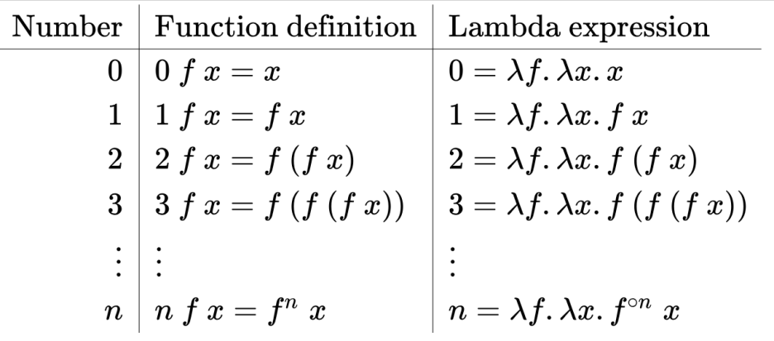
Church numerals
https://en.wikipedia.org/wiki/Church_encoding
All Church numerals are functions that take two parameters. Church numerals 0, 1, 2, ..., are defined as follows in the lambda calculus.
Starting with 0 not applying the function at all, proceed with 1 applying the function once, 2 applying the function twice, 3 applying the function three times, etc.:

Slide 18
successor function
After defining the Church numerals, we can define the numerical operations.
The first one is to define a successor function s. It is basically a function that increments a Church numeral by 1.
Thus, the successor is a function that takes a Church numeral representing the number n and returns a Church numerical representation of n+1.
For example, if λf.λx.f(f x) represents the number 2, if we apply the successor function s to that, we will get λf.λx.f(f(f x)) (Church numerical representation of number 3).
The successor function is defined as follows:
s(n) =λn.λf.λx.f((n f) x), where n is the Church numeral n.

Slide 19
successor function (I)
After defining the Church numerals, we can define the numerical operations.
The first one is to define a successor function s. It is basically a function that increments a Church numeral by 1.
Thus, the successor is a function that takes a Church numeral representing the number n and returns a Church numerical representation of n+1.
For example, if λf.λx.f(f x) represents the number 2, if we apply the successor function s to that, we will get λf.λx.f(f(f x)) (Church numerical representation of number 3).
The successor function is defined as follows:
s(n) =λn.λf.λx.f((n f) x), where n is the Church numeral n.

Slide 20
successor function (II)
s(n) =λn.λf.λx.f((n f) x), where n is the Church numeral n.
Let’s analyze it:
Input: n (a Church numeral), f (a function), and x (an argument)
Application of n: The term (nf)x represents the application of the function f to the argument x n times.
Additional Application: The term f((nf)x) applies f one more time to the result of (nf)x.
If the Church numeral n means to do something n times, s n means do something n+1 times.

Slide 21
successor function Example (I)
Church numeral for 2: λf.λx.f(f x)
Applying successor of this expression:
We know that s(n) = λn.λf.λx.f((n f) x)
Our n = 2 = λf.λx.f(f x)
Thus, we apply the successor function on that:
s(λf.λx.f(f x)) = ( λn.λf.λx.f((n f) x) )( λf.λx.f(f x) )
Using the first β-reduction on the application expression:
(λ param . output)input => output [param := input] => result
( λn.λf.λx.f((n f) x) )( λf.λx.f(f x) ) => λf.λx.f((n f) x) [n := λf.λx.f(f x)]
=> λf.λx.f((λf.λx.f(f x) f x)

Slide 22
successor function Example (II)
Now, let’s analyze the inner application expression:
(λf.λx.f(fx) f x
The underlined term is the Church numeral 2, right? And it can be read as:
Given a function f, apply f 2 times to its argument, which is x.
(λf.λx.f(fx) f x turns into f(f x)
Substituting on our expression λf.λx.f((λf.λx.f(fx) f x), we get:
λf.λx.f(f(f x)), which is exactly the Church numerical representation of the number 3!

Slide 23
addition and multiplication
The addition of two numbers m + n is defined as:
ADD(m, n) = λm.λn.λf.λx.(m f)((n f) x)
Thus, if we define m and n as the Church numerical representations of 3 and 4, respectively, and then apply this ADD function, we will get the Church numerical representation of 7.
The same logic applies to multiplication of two numbers m * n:
MUL(m, n) = λm.λn.λf.λx.m (n f)

Slide 24
Booleans
in Lambda Calculus, the Church definition of true and false are defined as functions of two parameters:
true chooses the first parameter.
false chooses the second parameter.
TRUE = λx.λy.x
FALSE = λx.λy.y

Slide 25
NOT
NOT: Takes a Boolean and returns the opposite.
NOT = λp. p FALSE TRUE
This means: “Take a Boolean function p. Apply p to the two parameters FALSE TRUE."
Remember the definition of booleans on Church enconding? TRUE returns the first parameter and FALSE returns the second parameter? Thus:
→ If p is TRUE, it returns FALSE.
→ If p is FALSE, it returns TRUE.

Slide 26
AND
AND: Takes two Booleans and returns TRUE if both are TRUE, otherwise FALSE.
AND = λp.λq.p q p
This means: “Take two Boolean functions p and q. Apply p to q and p."
Let’s try on practice:
AND TRUE FALSE = (λp.λq.p q p) TRUE FALSE:
Given TRUE and FALSE, return TRUE FALSE TRUE: (p = TRUE)
=> TRUE FALSE TRUE = λx.λy.x FALSE TRUE
Given FALSE and TRUE, return the first parameter:
λx.λy.x FALSE TRUE = FALSE

Slide 28
What is a Function? [1]
Functions as graphs
Given sets X and Y, a function from X to Y is a set of ordered pairs F of members of these sets such that for every x in X there is a unique y in Y for which the pair (x, y) is in F.
Functions as rules
To give a function means to give a rule for how the function is to be calculated.
A rule can be given by a formula f(x) = x²

Slide 29
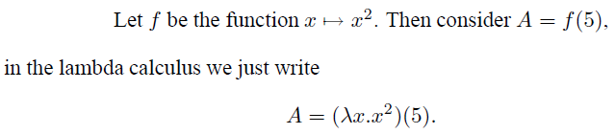
The Lambda Calculus
Language of expressions
Arithmetic
An expression such as x+y stands for the result of an addition
The lambda calculus extends the idea of an expression language to include functions.
The lambda calculus is a theory of functions as formulas.
It is a system for manipulating functions as expressions.

Slide 30
First-Class Function
A programming language is said to have first-class functions if it treats functions as first-class citizens.
Specifically, this means the language supports passing functions as arguments to other functions, returning them as the values from other functions, and assigning them to variables or storing them in data structures.

Slide 31
Lexical and Dynamic Scoping
https://web.archive.org/web/20150207225438/http://courses.cs.washington.edu/courses/cse341/08au/general-concepts/scoping.html
Scope rules define the visibility rules for names in a programming language. What if you have references to a variable named k in different parts of the program? Do these refer to the same variable or to different ones?
Languages such as Haskell, Algol, Ada, C, Pascal and Scheme are lexically scoped. A block defines a new scope. Variables can be declared in that scope, and aren't visible from the outside.
Some older languages use dynamic scoping. Using this scoping rule, we first look for a local definition of a variable. If it isn't found, we look up the calling stack for a definition.

Slide 32
Closure

Slide 33

Thank You & See You Again

